Slide 1
Chapter 5 Recursion Đệ: đưa ra/ Quy: quay về

Slide 2
Objectives
LO3.1 Describe the basic ideas of recursion and how to set up recursive systems that represent certain real-world phenomena.
LO3.2 Know how to develop recursive algorithms and programs
LO3.3 Write programs in Java using recursion to solve some problems, like creating the Fibonacci sequence.
LO3.4 Analyse a recursive function to find out its’ ouput without running.
LO3.5 Explain type of recursive functions, give examples and comparing them.
LO3.6 Compare recursion with iteration, analyzes their pros and cons

Slide 3
Contents
Questions:
What is recursion? Some examples
How to understand a recursion?
Where to use recursive definitions?
How to describe a recursive operation?
How to analyse an operation using recursive view?
How to implement recursive function?
How to manage running functions?
Anatomy of a Recursive Call
Evaluating performance of recursive methods.
How to classify recursive functions?
Evaluating recursive implementation

Slide 4
What is recursion?
A technique in which a concept/an operation is defined by itself
Person = a child of other two persons
A technique to present an operation using itself
Factorial : n! = n* (n-1)!
Sequence of numbers:
F(n) = F(n-1) + F(n-2) // Fibonacci
a(n) = a(n-1)+ r: Arithmetic progression – CS cộng
b(n) = q*b(n-1) // geometric progression- CS nhân

Slide 5
What is recursion? ….
Recursive implemention is a function/ method whose body containing one or more calls to itself.
public static int fibo ( int n){
if (n<2) return 1;
return fibo(n-1) + fibo(n-2);
}

Slide 6
How to understand a recursion?
We agree/define initial data.
Rules for deduction (suy diễn)
Examples:
Person = a child of other two person
Initial persons: Adam, Eve
1 3 5 7 9 ….. A(n) = 1, n=1
A(n) = A(n-1) + 2, n> 1
1, 1, 2, 3, 5, 8, 13, … F(n) = 1, n<2
F(n) = F(n-1) + F(n-2)

Slide 7
Where to use Recursive Definitions
Recursive definitions serve two purposes:
Generating new elements
Testing whether an element belongs to a set
Recursive definitions are frequently used to define functions and sequences of numbers
A way to express a loop when number of executions is not known in advance.

Slide 8
How to describe a recursive operation?
A recursive definition consists of two parts:
The anchor or ground case or base case, the basic elements that are the building blocks of all other elements of the set
Rules that allow for the construction of new objects out of basic elements or objects that have already been constructed

Slide 9
How to analyse an operation using recursive view?
Divide and conquer – chia để trị
Data: d1, d2, d3, d4, d5, ………, dn
Method:
1 1 2 3 5 8 13 21 34
Splitting one or some elements at one side. This helps to identify ground case.
1
Exploring relation between an element with previous others
→ Deductive rules:F(n) = F(n-2) + F(n-1)

Slide 10
How to implement recursive function?
Analyse operation using recursive view then express it using pseudo-code.
Implementing exactly pseudo-code.
Example: Calculate factorial of the integer n
Analysis: n! = 1*2*3*4*5* …. * (n-2)*(n-1) * n
(n-1)!
Pseudo-code
factorial ( n) = 1, n<2
= n* factorial(n-1)

Slide 11
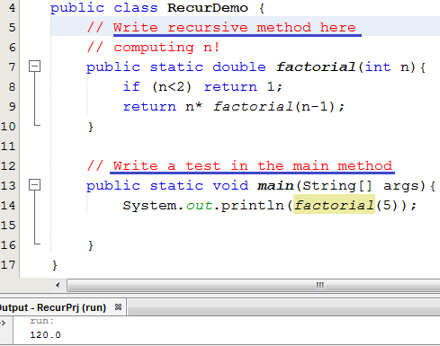
How to practice recursive function efficiently?
package recur;
Pseudo-code
n! = 1, n<2
= n* (n-1)!, n>=2
2 lines

Slide 12
Practice:
Fibonacci numbers: 1 1 2 3 5 8 13 21 ….
fibo(n) =
Code: …
Arithmetic progression:
a: first element, r: common difference
ap(n)=
Code:
…

Slide 13
How to implement recursive function… Practice:
Geometric progression:
a: first element, q: common multiplier
gp=
Code: ….
Calculate sum of integral array having n elements
S = 0 + a[0] + a[1] + …….. + a[n-2] + a[n-1]
S = ….
Code: …….

Slide 14
How to implement recursive function… Practice:
Calculate the maximum value in an integral array having n elements
1 5 9 7 2 10 9
max(a,n) = …
Code:
Calculate the minimum value in an integral array having n elements
min (a,n) = …
Code: ….

Slide 15
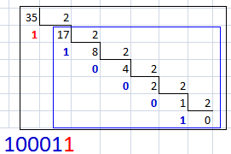

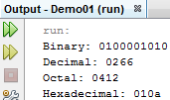
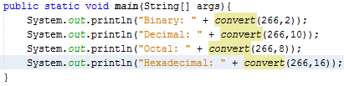
How to implement recursive function… Practice:
Convert a decimal integer to a numeric string in specific base number system
n= 35, base=2 ➔ 100011
“100011” = “10001” + “1”
convert(35,2) = convert(17,2) + digit of 35%2
convert(n,base) = convert(n/base,base) + digit of n%base
Anchor: If n==0 return “0”

Slide 16
How to manage running functions?
How to manage a thing? ➔ We need its data.
How to manage a running method? ➔ … ?
Data of a method:
Its parameters (data type, value)
Its return data type
Its extra local variables
Return address in its caller
Dynamic link: Address of its caller activation record
Activation record:
Data which are used to manage running methods

Slide 17
More details:
Activation records contain the following:
Values for all parameters to the method, location of the first cell if an array is passed or a variable is passed by reference, and copies of all other data items
Local (automatic) variables that can be stored elsewhere
The return address to resume control by the caller, the address of the caller’s instruction immediately following the call

Slide 18
Method Calls and Recursion Implementation (continued)
A dynamic link, which is a pointer to the caller’s activation record
The returned value for a method not declared as void

Slide 19
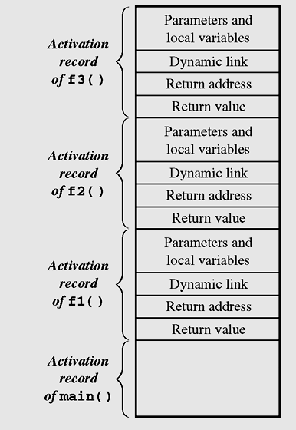
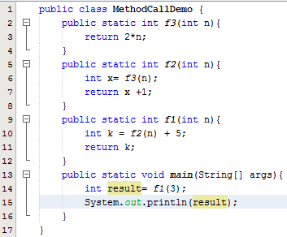

More details:….
Figure 5-1 Contents of the run-time stack when main() calls method f1(), f1() calls f2(), and f2() calls f3()

Slide 20
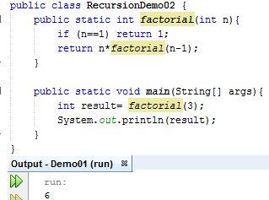
Anatomy of a Recursive Call
AR of factorial(1)
AR of factorial(2)
AR of factorial(2)
AR of factorial(2)
AR of factorial(3)
AR of factorial(3)
AR of factorial(3)
AR of factorial(3)
AR of factorial(3)
AR of main
AR of main
AR of main
AR of main
AR of main
AR of main
AR of main

Slide 21
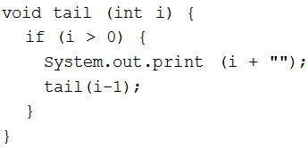
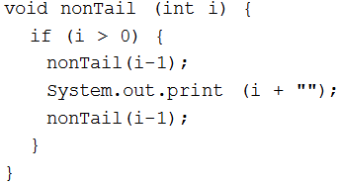
How to classify recursive functions?
Based on the place where a recursive method is called → Tail recursion and non-tail recursion.
Tail recursion is characterized by the use of only one recursive call at the very end of a method implementation

Slide 22
How to classify recursive functions?
Based on number of recursive calls: Linear, non-linear recursion.
int factorial ( int n) {
if (n==1) return 1;
return n*factorial(n-1);
}
int fibo ( int n) {
if (n<3) return 1;
return fibo(n-2) + fibo(n-1);
}

Slide 23
How to classify recursive functions?
Based on number of functions included in recursive call: → Indirect recursion.
receive(buffer)
while buffer is not filled up
if information is still incoming
get a character and store it in buffer;
else exit();
decode(buffer);
decode(buffer)
decode information in buffer;
store(buffer);
store(buffer)
transfer information from buffer to file;
receive(buffer);

Slide 24
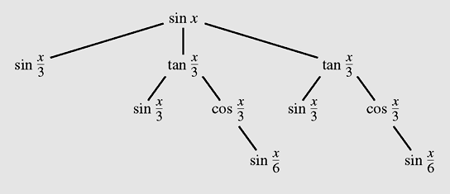
Indirect Recursion (continued)
Figure 5-7 A tree of recursive calls for sin (x)

Slide 25
Evaluating performance of recursive methods.
Space: Need more memory for activation records.
Time: Call functions many time → More overhead task must be perform → low
If you can, you should not use recursion.
How to remove recursion?
Use loop + stack/ queue data structure
For details: See tutorial of this chapter.

Slide 26
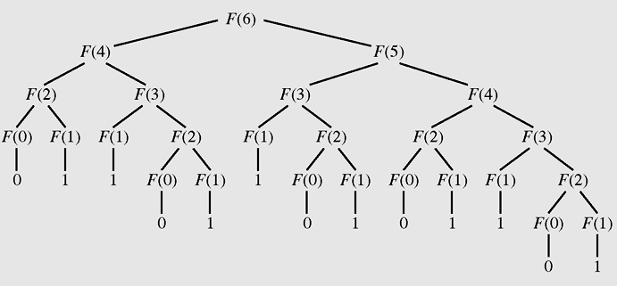
Evaluating: Excessive Recursion
Figure 5-8 The tree of calls for Fib(6)
One operation must be performed many times.

Slide 27
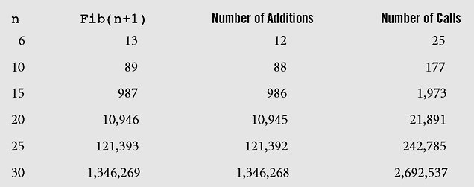
Evalating: Excessive Recursion
Figure 5-9 Number of addition operations and number of recursive calls to calculate Fibonacci numbers

Slide 28
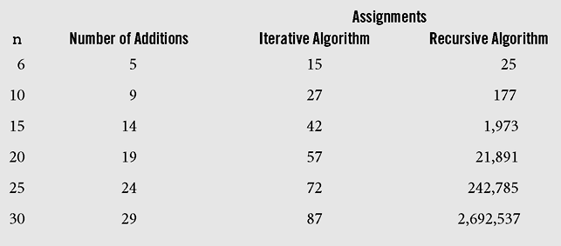
Evalating: Excessive Recursion
Figure 5-10 Comparison of iterative and recursive algorithms for calculating Fibonacci numbers

Slide 29
Backtracking
Backtracking is a technique for returning to a given position (e.g., entry point) after trying other avenues that are unsuccessful in solving a particular problem.

Slide 30
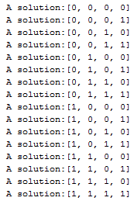
Backtracking…
The 4-bit string generating Problem
BooleanSet = {0,1}
Domain | 1 0 | 1 0 | 1 0 | 1 0
varSet | var0 | var1 | var2 | var3
solver
Satisfied proposal | 0 | 0 | 1 | 1
Proposal evaluator
(no checking in this case)
4 variables
Solutions

Slide 31
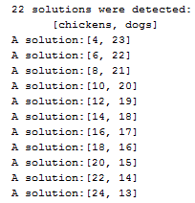
Backtracking…
Chicken and Dogs Problem:
Group including some chickens and dogs and total of number of legs is 100.
at least 1 chicken and 1 dog.
* number of chickens =?
* number of dogs = ?
DogDomain = {1,.., (100-2)/4}
ChickDomain = {1,.., (100-4)/2}
Domain | … 1 0 | … 1 0
varSet | var0 | var1
solver
Satisfied proposal | 8 | 21
Evaluator:
[Var0]* 2 + [var1]* 4 == 100
Solutions
2 variables

Slide 32
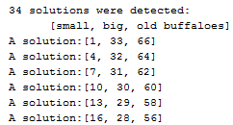
Backtracking…
The Buffaloes Problem:
number of buffaloes = number of whisks =100
* Each small buffalo can eat 1 whisk
* Each big buffalo can eat 2 whisks
* Two old buffaloes share 1 whisk
* Computer number of buffaloes in each group.
Small{0,100}
Big{0,50}
Old{0,100}
Domain | … 1 0 | … 1 0 | … 1 0
varSet | var0 | var1 | var2
solver
Satisfied proposal | 16 | 28 | 56
Proposal evaluator
var2 is even And
var0 + 2*var1 + var2/2 =100
And
var0 + var1 + var2=100;
Solutions
3 variables

Slide 33
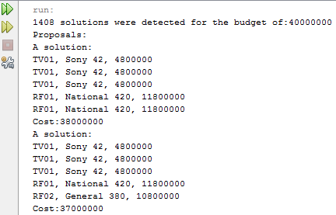
Backtracking…
Consumer Consulting Problem:
The problem: A customer needs proposals for buying some items
* (3 televisions, 2 refrigerators)
* with the total cost less than or equals to a specific budget
(Ex: 40 000 000)
➔ 5 variables
var0 → TV set
var1 → TV set
var2 → TV set
var3 → Refrigerator set
var4 → Refrigerator set
A proposal is satisfied if total cost of items is less than or equals to specific budget.

Slide 34
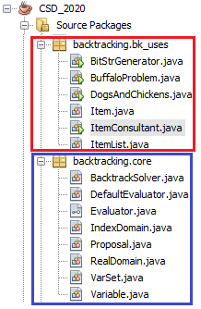
Backtracking: Demo.
Project structure
-Generating Bit strings Problem
-Problem of buffaloes
-Problem of dogs and chickens
-Item
-Consumer consultant
-List of items
-Solver using backtracking
-Default class for proposal evaluator
-Interface for a evaluator
-Domain containing indices
-A proposal for a solution
-Real domain containing real objects
-Set of variables
- A variable in problem

Slide 35
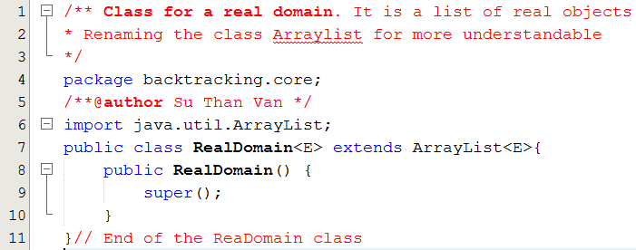
Backtracking: Demo.

Slide 36
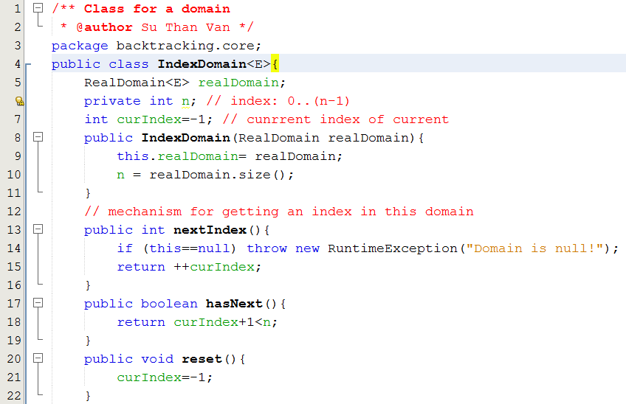
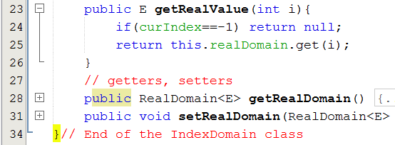
Backtracking: Demo.

Slide 37
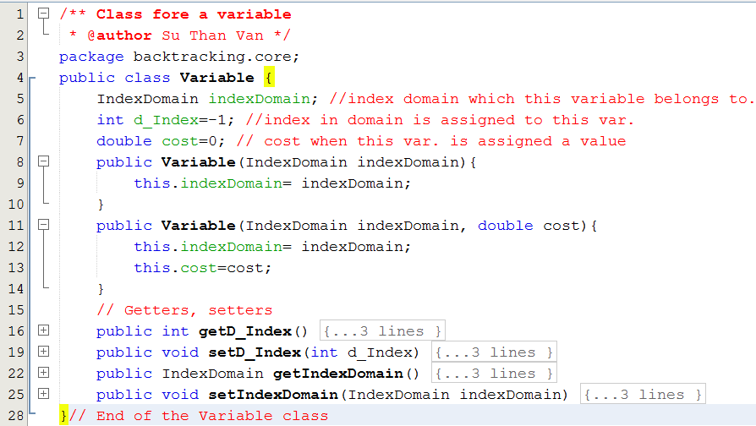
Backtracking: Domo.

Slide 38
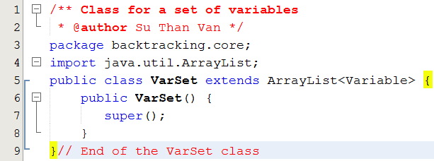
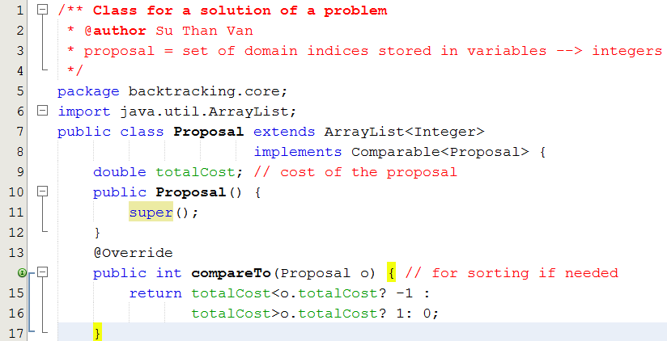
Backtracking: Demo.

Slide 39
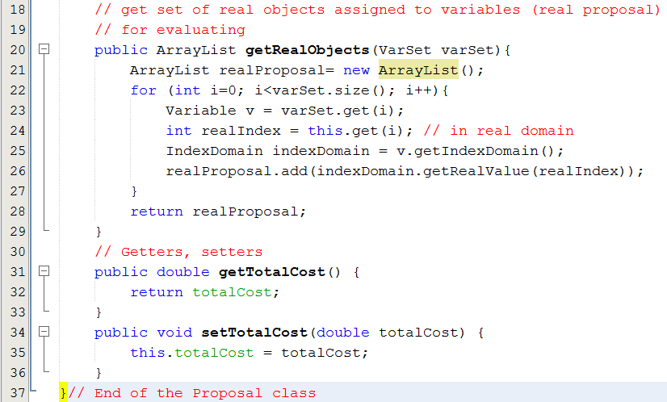
Backtracking: Demo.

Slide 40
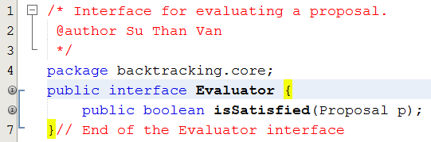
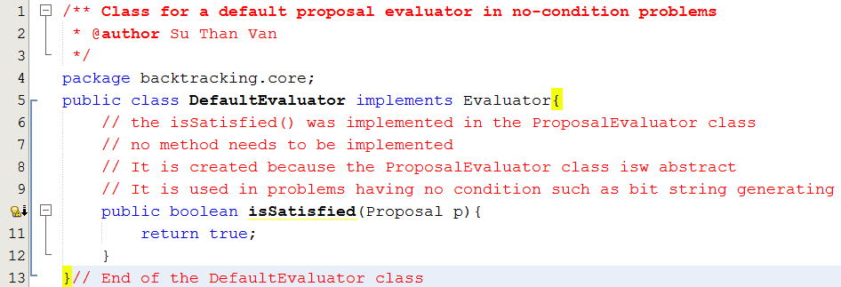
Backtracking: Demo.
Each specific problem has a individual way to check whether a proposal is satisfied its conditions or not. So, an interface is needed.

Slide 41
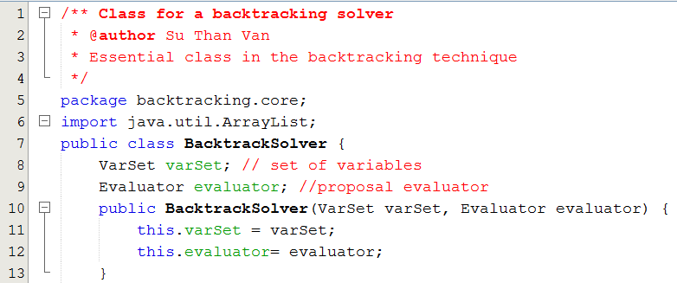
Backtracking: Demo.

Slide 42
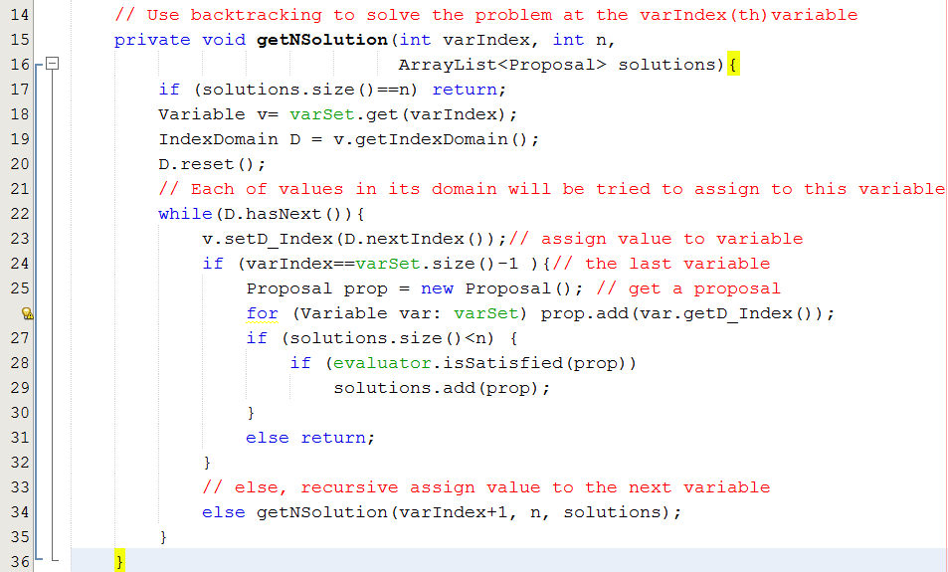
Backtracking: Demo.

Slide 43
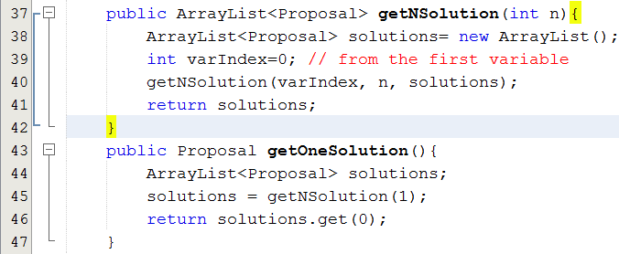
Backtracking: Demo.

Slide 44
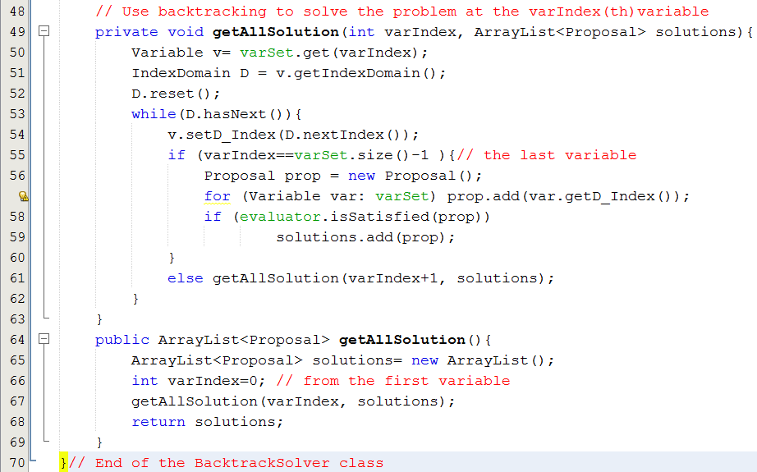
Backtracking: Demo.

Slide 45
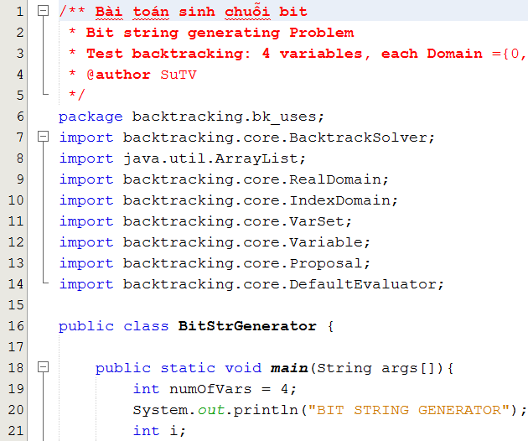
Backtracking: Demo.
Generating Bit String Problem

Slide 46
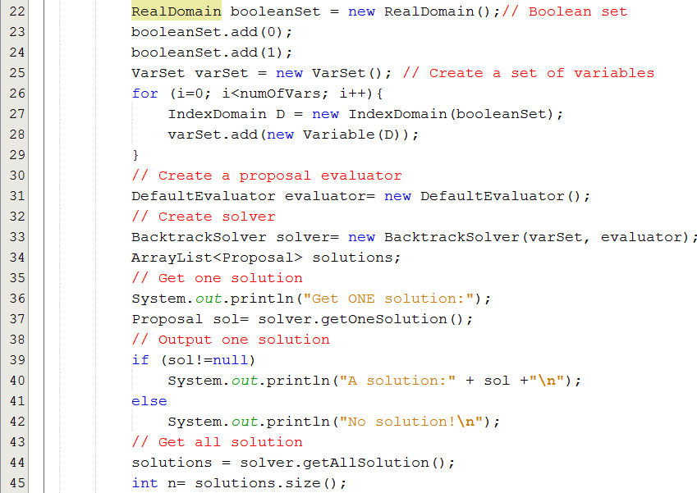
Backtracking: Demo.
Generating Bit String Problem

Slide 47
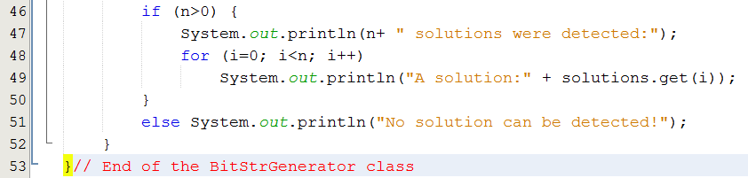
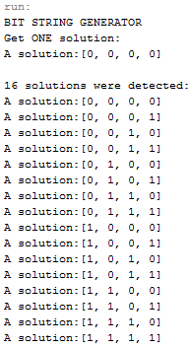
Backtracking: Demo.

Slide 48
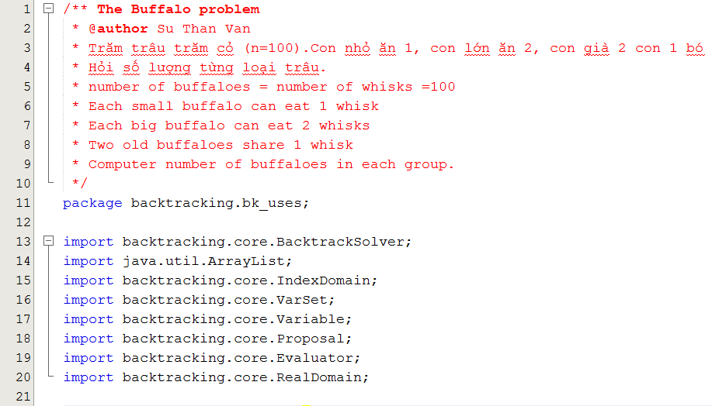
Backtracking: Demo.
Buffaloes Problem

Slide 49
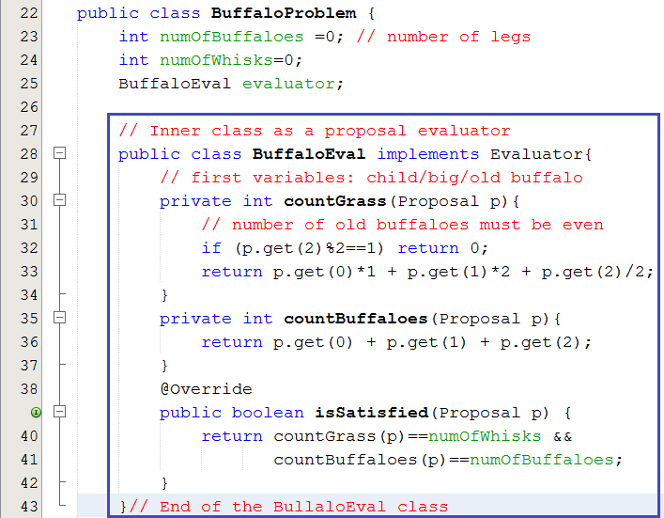
Backtracking : Demo.
Buffaloes Problem

Slide 50
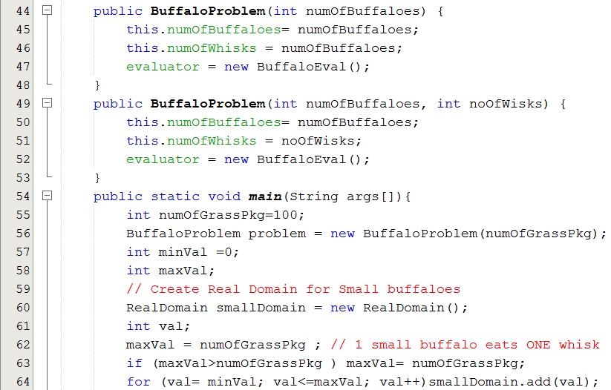
Backtracking : Demo.
Buffaloes Problem

Slide 51
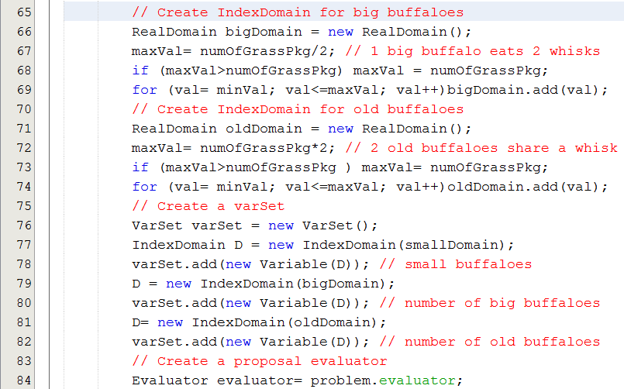
Backtracking : Demo.
Buffaloes Problem

Slide 52
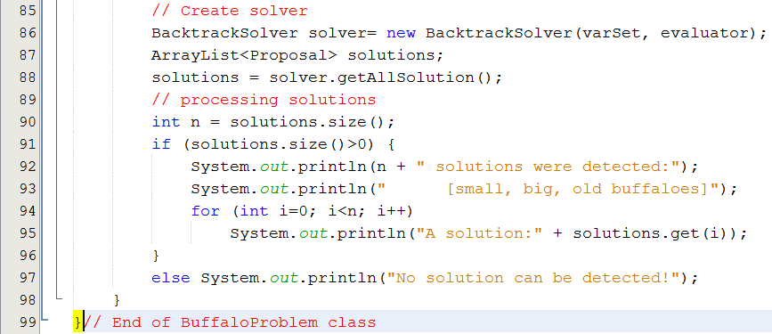
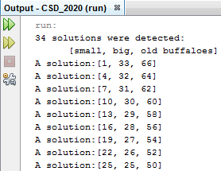
Backtracking : Demo.
Buffaloes Problem

Slide 53
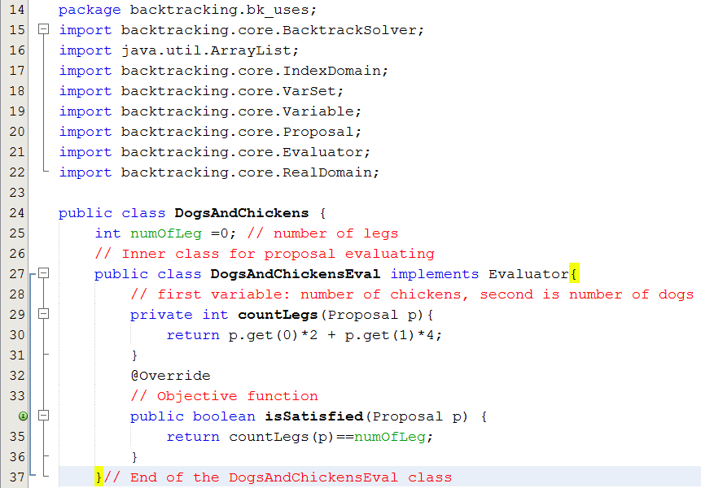
Backtracking : Demo.
Dogs and Chickens Problem

Slide 54
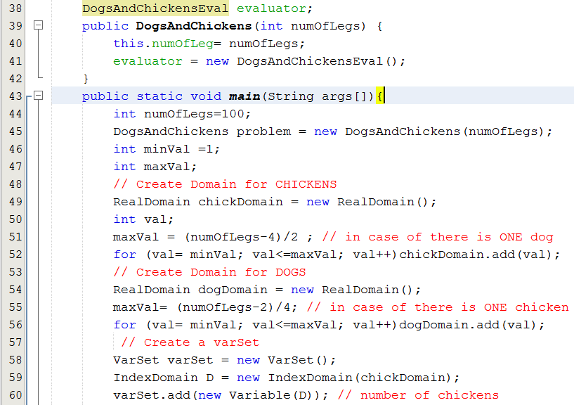
Backtracking : Demo.
Dogs and Chickens Problem

Slide 55
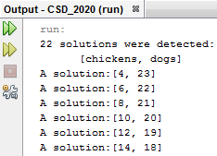
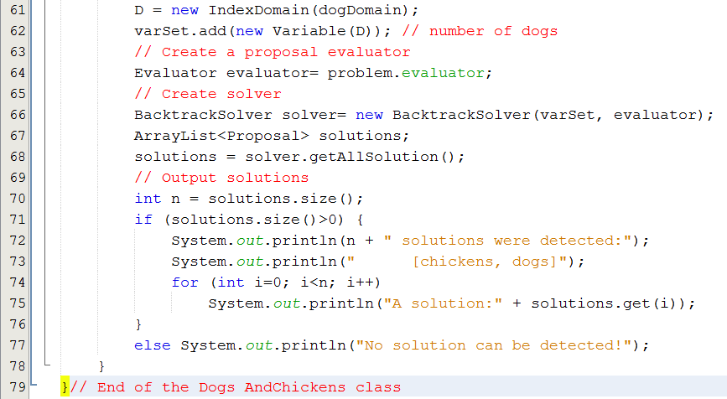
Backtracking : Demo.
Dogs and Chickens Problem

Slide 56
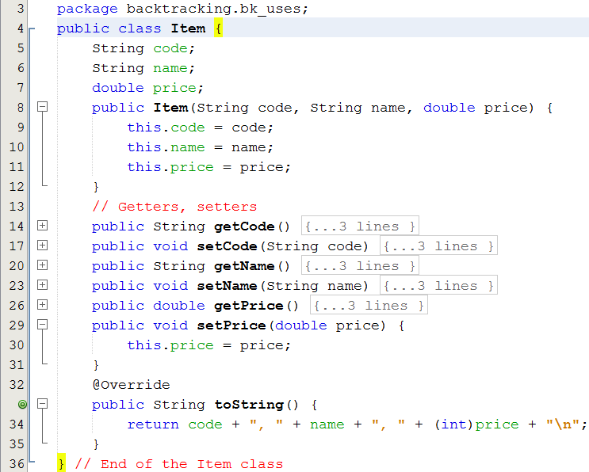
Backtracking : Demo.
Item Consultant Problem

Slide 57
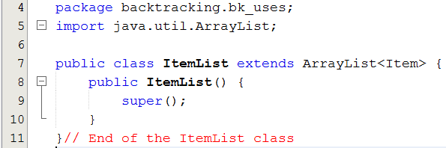
Backtracking : Demo.
Item Consultant Problem

Slide 58
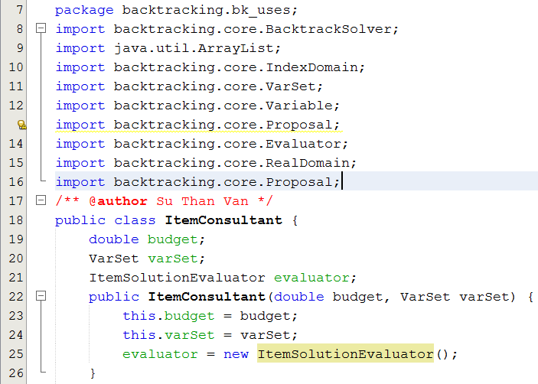
Backtracking : Demo.
Item Consultant Problem

Slide 59
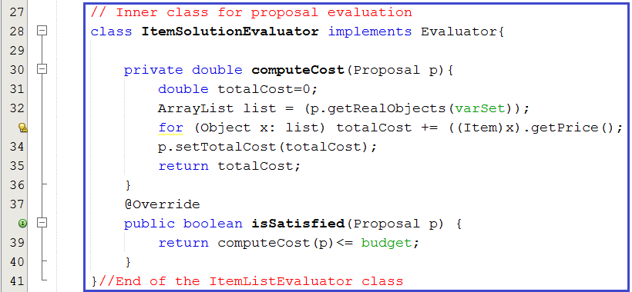
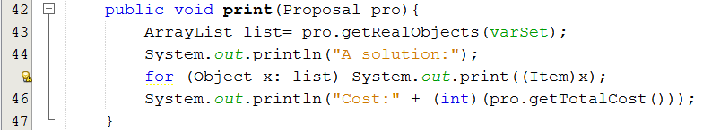
Backtracking : Demo.
Item Consultant Problem

Slide 60

Backtracking : Demo.
Item Consultant Problem

Slide 61

Backtracking : Demo.
Item Consultant Problem

Slide 62


Backtracking : Demo.
Item Consultant Problem

Slide 63
Backtracking : Demo.
Steps to use backtracking technique
Setup real domains | Setup index domains | Setup VarSet | Setup problem + Evaluator | Create solver | Process solution
rDom0 | iDom0 | var0 | varSet + evaluator | varSet + evaluator | solutions
rDom1 | iDom1 | var1
rDom2 | iDom2 | var2
rDom3 | iDom3 | var3
rDom4 | iDom4 | var4

Slide 64
Review

LO3.1 Describe the basic ideas of recursion and how to set up recursive systems that represent certain real-world phenomena.
LO3.2 Know how to develop recursive algorithms and programs
LO3.3 Write programs in Java using recursion to solve some problems, like creating the Fibonacci sequence.
LO3.4 Analyse a recursive function to find out its’ ouput without running.
LO3.5 Explain type of recursive functions, give examples and comparing them.
LO3.6 Compare recursion with iteration, analyzes their pros and cons






Slide 65
Review
LO3.4 Analyse a recursive function to find out its’ ouput without running.
int T (int n) {
if(n<2) return 2;
return T(n-2) + 2*T(n-1) + 3;
}
T(4)=?
T(n) = 2, n<2
= T(n-2) + 2T(n-1) +3, n>=2
T(4)=?
n | 0 | 1 | 2 | 3 | 4
T(n) | 2 | 2 | 9 | 23 | 58
Testing whether the value 60 is an element of the T sequence?
→ NO
How to use recursion for testing whether a value belongs to a group? Please refer to Recursion Review → LMS/ CSD201-SuVan.

Slide 66
Summary
Recursive definitions are programming concepts that define themselves
Recursive definitions serve two purposes:
Generating new elements
Testing whether an element belongs to a set
Recursive definitions are frequently used to define functions and sequences of numbers
Recursive thinking: Use divide and conquer technique.

Slide 67
Summary (continued)
Tail recursion is characterized by the use of only one recursive call at the very end of a method implementation.
Backtracking is a technique for returning to a given position (e.g., entry point) after trying other avenues that are unsuccessful in solving a particular problem.

Slide 68
Ôn tập – Viết vào vở
1- Đệ quy là gì?
2- Con người có dùng kỹ thuật đệ quy hay không? Cho hai thí dụ.
3- Làm sao con người hiểu được đệ quy?
4- Tác vụ đệ quy được mô tả như thế nào? Cho thí dụ.
5- Làm sao có được kỹ năng diễn đạt đệ quy?
6- Đệ quy được dùng để làm gì?
7- Đệ quy đuôi là gì?
8- Đệ quy đầu là gì?

Slide 69
Ôn tập – Viết vào vở
9- Đệ quy tuyến tính là gì?
10- Đệ quy phi tuyến là gì?
11- Đệ quy gián tiếp là gì?
12- Đệ quy hỗ tương là gì?
13- Làm sao hệ thống có thể quản lý các hàm đang thực thi?
14- Hãy cho biết activation record của một hàm gồm có những gì cùng với ý nghĩa của từng thành phần.
15- Tại sao hàm đệ quy khi thực thi lại tốn bộ nhớ?
16- Tại sao hàm đệ quy thực thi lại chậm?

Slide 70
Ôn tập – Viết vào vở
17- Khử đệ quy là gì? Tại sao lại nên khử đệ quy?
18- Khử đệ quy bằng cách nào?
19- Hồi quy là gì?
20- Kỹ thuật hồi quy có thể được dùng trong những bài toán nào? Cho ví dụ.

